Slide 1
COSC2430 – Exam 1 Review

Slide 2
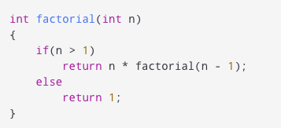
Recursion
Potential questions:
Write a recursive function that returns the result of a factorial (like above)
What is the output of the function above?

Slide 3
Linked List
Singly linked list
Doubly linked list
Potential questions:
Know how to code these operations: (LinkedList class will be given, only focus on function implementation)
Insert() – atBeg, atMid, atNth, atLast
Delete() - atBeg, atMid, atNth, atLast
printList()
printInReverse()

Slide 4
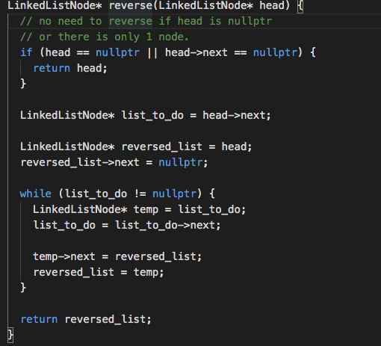
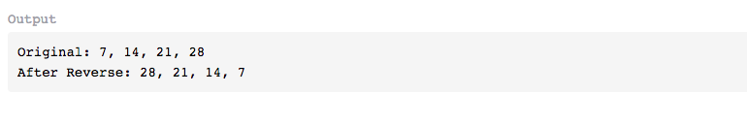
Linked List (continued)
Trace the output of a linked list function:
You’ll have to guess what the function does. Function will be named secretFunc() or something similar.

Slide 5
Stack
Potential questions:
Know how to code stack operations
IsEmpty()
Push()
Pop()
Infix <-> Postfix conversion.
Trace the output of a stack

Slide 6
Sorting
Selection sort
Bubble sort
Merge sort
Quick sort
Radix Sort
Potential questions:
Know how to code these
Given a sorting function, which sort is it?
[5 1 4 2 8] trace this using selection sort.

Slide 7
Sorting
Selection sort
Bubble sort
Merge sort
Quick sort
Radix Sort
Potential questions:
Know how to code these
Given a sorting function, which sort is it?
[5 1 4 2 8] trace this using selection sort.

Slide 8
Sorting
Selection sort
Bubble sort
Merge sort
Quick sort
Radix Sort
Potential questions:
Know how to code these
Given a sorting function, which sort is it?
[5 1 4 2 8] trace this using selection sort.

Slide 9
Sorting
Selection sort
Bubble sort
Merge sort
Quick sort
Radix Sort
Potential questions:
Know how to code these
Given a sorting function, which sort is it?
[5 1 4 2 8] trace this using selection sort.

Slide 10
Big 0
Look for example operations with the following time complexity
O(1)
O(n)
O(n^2)
O(logn)
O(nlogn)
O(mn)
O(m+n)
Resources:
https://guides.codepath.org/compsci/Big-O-Complexity-Analysis
https://www.youtube.com/watch?v=v4cd1O4zkGw&ab_channel=HackerRank

